Slide 1

Dina Ahmed lecturer, Medical Parasitology
Bachelor degree in Medicine & Surgery
Masters of Medical Sciences
Doctorate degree in Medical Parasitology

Slide 2
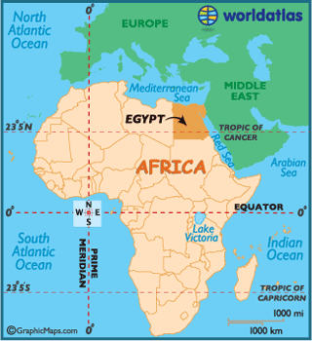
Home land: Egypt

Slide 3


Slide 4


Slide 5


Slide 6

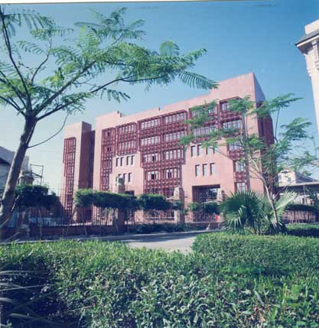
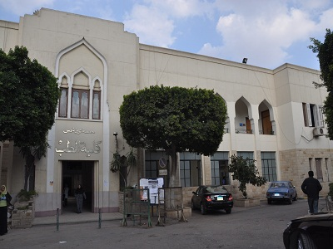
Academic & Research Institute: Department Of Medical Parasitology, Faculty Of Medicine, Ain Shams University

Slide 7
Main Research Interests:
Neglected tropical diseases (vector-borne) surveillance using immunological and molecular approaches.
Lymphatic Filariasis
GPELF
WHO/TDR

Slide 8

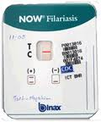
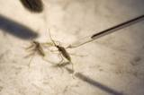
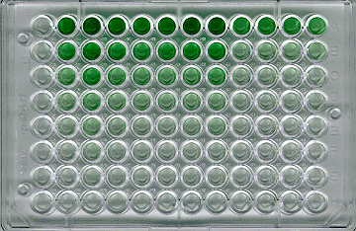
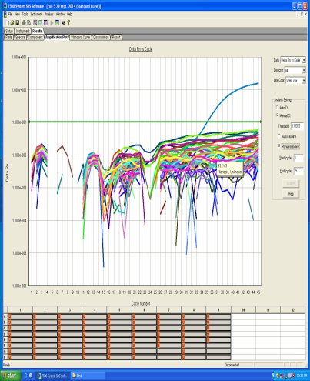
Monitoring of infection levels
Human populations
Antigenemia
Antifilarial antibodies
Mosquito vectors
Dissection
Molecular xenomonitoring

Slide 9
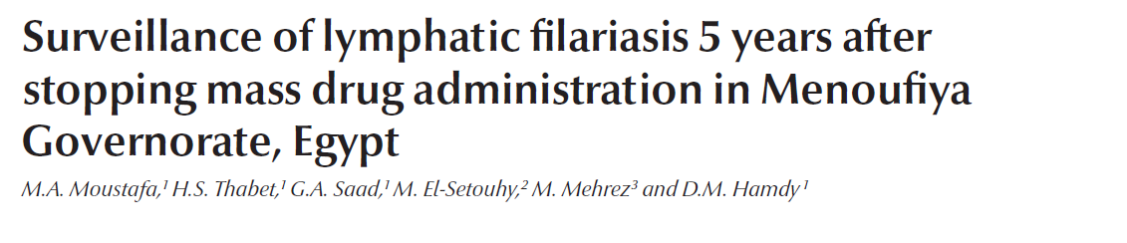
This work was sponsored by the WHO Regional Office for the Eastern Mediterranean, in collaboration with the Special Program for Research and Training in Tropical Diseases (TDR), Joint EMRO/TDR Small Grants Scheme for implementation research in communicable diseases (grant no. ID SGS 10/43).

Slide 10
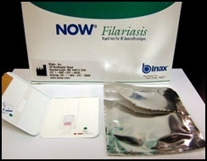
1-Detection of CFA in capillary blood
Immuno-chromatographic Card Test

Slide 11
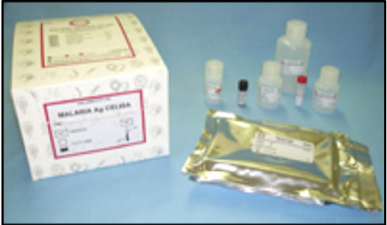
2-Detection of IgG Ab to the Recombinant Bm14 antigen in plasma (CELISA)

Slide 12
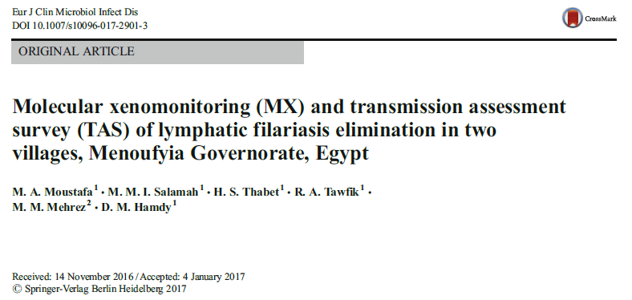
This work was sponsored by the WHO Regional Office for
the Eastern Mediterranean, in collaboration with the Special Program for Research and Training in Tropical Diseases (TDR), Joint EMRO/TDR Small Grants Scheme for implementation research in communicable diseases (grant no. ID SGS 13/58).

Slide 13
Molecular Xenomonitoring (MX)
It is the detection of parasite DNA in mosquitoes by polymerase chain reaction [PCR].
This method requires collection of representative samples of mosquitoes, efficient isolation of total DNA from mosquito pools, amplification of parasite DNA sequences, and detection of the amplified product (Rao et al.,2006).

Slide 14





Slide 15

Parasitology Research and Diagnostic Laboratory Unit :
Sample analysis for patients for spot diagnosis of different parasitic stages (Stool, Urine, blood, vaginal smear, etc….).
Staining techniques (e.g. MZN stain for Coccidian, Trichrome and Iron Hx for Entamoeba histolytica).
Stool Concentration techniques (Formol ether, Zn Sulphate).
Stool culture (e.g. Nematode larvae).

Slide 16
Blood film (thin and thick) stained by Geimsa stain for detection of Blood parasites (e.g. microfilaria of Filarial nematodes, Plasmodium stages,..).
Serology for detection of antibodies for diagnosis of Schistosomiasis, fascioliasis and hydatid disease.
Urine analysis (e.g. Enterobius eggs in females).

Slide 17
Scientific Goals (PostDoc.):
Insecticide resistance monitoring in Malaria mosquito vectors
Susceptibility test
ACE-1/Kdr-gene mutation detection

Slide 18
Contributions:
Entomologist.
Molecular biologist.
Bioinformatics.
Statistics.

Slide 19
Collaborators:
The Concerned technical unit in WHO/EMRO (Malaria Control & Elimination) is interested in funding (Entomological surveillance).
Molecular Parasitology Dep., Bernard Nocht Institute (BNI) for Tropical Medicine, Hamburg, Germany.

Slide 20
Obstacles:
Authority clearance and administrative delay (schedule ×).
Entomology research institute (No Partner).
Samples exportation (impossible).

Slide 21



